Slide 1

Sevda Heydarova

Slide 2

About
Upon receiving the Excel file, it became evident that the dataset was contaminated with irregularities. Prior to analysis, an essential preliminary step involved meticulously cleansing the data. This presentation will elucidate the systematic approach employed to rectify and refine the dataset. The concluding segment will unveil the my method applied in the subsequent analysis. Let's start.

Slide 3
StePS IN EXCEL
01
To ensure uniformity, the initial step involved selecting the entire dataset by pressing Ctrl+A. Subsequently, the alignment of all columns was standardized to the left for a cohesive presentation of data. This uniform alignment facilitates clarity and ease of interpretation across the dataset.

Slide 4
STEPS IN EXCEL
01
02
03
To ensure uniformity, the initial step involved selecting the entire dataset by pressing Ctrl+A. Subsequently, the alignment of all columns was standardized to the left for a cohesive presentation of data. This uniform alignment facilitates clarity and ease of interpretation across the dataset.
At the outset, the focus was on enhancing data clarity by replacing blank entries within the Shipping and Manufacturer columns with the placeholder "undefined". Subsequently, efforts were made to refine specific rows, addressing individual cases where appropriate. I used if and isblank functions:
=if(isblank($I2),”undefined”, $I2)
After filtering the Price Currency column, it revealed two currency types: CAD and USD. With only one CAD row, a decision was made to convert it to USD aligning it with the prevailing currency condition, for consistency and clarity during analysis..

Slide 5
STEPS IN EXCEL
01
02
03
To ensure uniformity, the initial step involved selecting the entire dataset by pressing Ctrl+A. Subsequently, the alignment of all columns was standardized to the left for a cohesive presentation of data. This uniform alignment facilitates clarity and ease of interpretation across the dataset.
At the outset, the focus was on enhancing data clarity by replacing blank entries within the Shipping and Manufacturer columns with the placeholder "undefined". Subsequently, efforts were made to refine specific rows, addressing individual cases where appropriate. I used if and isblank functions:
=if(isblank($I2),”undefined”, $I2)
After filtering the Price Currency column, it revealed two currency types: CAD and USD. With only one CAD row, a decision was made to convert it to USD aligning it with the prevailing currency condition, for consistency and clarity during analysis.

Slide 6
STEPS IN EXCEL
04
The Price and Price Currency columns were merged by converting the Price column to USD currency format, ensuring precision through rounding. Following this consolidation, the Price Currency column was subsequently removed for a streamlined and cohesive dataset.

Slide 7
STEPS IN EXCEL
04
05
The Price and Price Currency columns were merged by converting the Price column to USD currency format, ensuring precision through rounding. Following this consolidation, the Price Currency column was subsequently removed for a streamlined and cohesive dataset.
Addressing irregularities in the Product Availability column, a systematic organization was implemented to standardize entries. Similar values, such as "available", "in stock", "true" and "yes" were consolidated and recorded uniformly as "In Stock". This process was repeated for other entries, resulting in a refined dataset featuring distinct categories: "In Stock", "Out Of Stock", "Special Order" and "Undefined".

Slide 8
STEPS IN EXCEL
04
05
06
The Price and Price Currency columns were merged by converting the Price column to USD currency format, ensuring precision through rounding. Following this consolidation, the Price Currency column was subsequently removed for a streamlined and cohesive dataset.
Addressing irregularities in the Product Availability column, a systematic organization was implemented to standardize entries. Similar values, such as "available", "in stock", "true" and "yes" were consolidated and recorded uniformly as "In Stock". This process was repeated for other entries, resulting in a refined dataset featuring distinct categories: "In Stock", "Out Of Stock", "Special Order" and "Undefined".
Upon reviewing the Product Condition column, irregularities akin to those in the Product Availability column were identified. To address this, a similar consolidation approach was applied. Rows such as "Seller refurbished", "Refurbished" and "Manufacturer refurbished" were combined and uniformly recorded as "Refurbished". The result of this effort yielded a streamlined and categorized dataset, now featuring only "New", "Refurbished" and "Used" conditions:
=if(isnumber(search(“New”,$E2)), “New”, if(isnumber (search(“Refurbished”,$E2)), “Refurbished”, ”, if(isnumber (search(“Pre-Owned”,$E2)), “Used”, ”,$E2)))

Slide 9
STEPS IN EXCEL
07
In the Shipping column, akin to the irregularities found in Product Condition and Product Availability columns, diverse entries were identified. Entries such as "Shipping charges apply“, "Freight" and numeric values displayed with USD or CAD were found to convey the same meaning. To harmonize and simplify, all these variations were uniformly changed to "Paid Delivery" and additional adjustments were made for consistency and clarity.

Slide 10
STEPS IN EXCEL
07
08
In the Shipping column, akin to the irregularities found in Product Condition and Product Availability columns, diverse entries were identified. Entries such as "Shipping charges apply“, "Freight" and numeric values displayed with USD or CAD were found to convey the same meaning. To harmonize and simplify, all these variations were uniformly changed to "Paid Delivery" and additional adjustments were made for consistency and clarity.
The Brand column underwent organization to standardize entries for consistency. Instances such as "Belkin" and "Belkin INC." were harmonized and recorded uniformly as "Belkin". Similar actions were iteratively applied to other related entries, ensuring a more coherent and refined dataset.

Slide 11
STEPS IN EXCEL
07
08
09
In the Shipping column, akin to the irregularities found in Product Condition and Product Availability columns, diverse entries were identified. Entries such as "Shipping charges apply“, "Freight" and numeric values displayed with USD or CAD were found to convey the same meaning. To harmonize and simplify, all these variations were uniformly changed to "Paid Delivery" and additional adjustments were made for consistency and clarity.
The Brand column underwent organization to standardize entries for consistency. Instances such as "Belkin" and "Belkin INC." were harmonized and recorded uniformly as "Belkin". Similar actions were iteratively applied to other related entries, ensuring a more coherent and refined dataset.
To enhance clarity in the Manufacturer column, adjustments were made based on the corresponding Brand column. For instance, upon observing ASUS Brand, discrepancies in the Manufacturer column were identified with entries such as "Asus" and "Undefined". To rectify this, the "Undefined" rows were updated to reflect "Asus" thereby reducing undefined entries and promoting a clearer representation in the Manufacturer column. I changed meaningless rows like "1 Year Warranty" with "Undefined".

Slide 12
Steps in excel
10
The Merchant column underwent refinement to enhance consistency. Similar entries, such as "17th St Photo Supply Inc" and "17thstreetphoto" were identified and harmonized for uniformity. This approach was iteratively applied to address other instances of similar entries, contributing to a more standardized and organized dataset.

Slide 13
Steps in excel
10
11
The Merchant column underwent refinement to enhance consistency. Similar entries, such as "17th St Photo Supply Inc" and "17thstreetphoto" were identified and harmonized for uniformity. This approach was iteratively applied to address other instances of similar entries, contributing to a more standardized and organized dataset.
To ensure a consistent and visually pleasing dataset, the "Proper" function was applied across all columns. This function systematically arranged the letters in a proper case format, standardizing the text and contributing to a more aesthetically coherent presentation throughout the entire dataset. For example:
=Proper(J2)

Slide 14
Steps in excel
10
11
12
The Merchant column underwent refinement to enhance consistency. Similar entries, such as "17th St Photo Supply Inc" and "17thstreetphoto" were identified and harmonized for uniformity. This approach was iteratively applied to address other instances of similar entries, contributing to a more standardized and organized dataset.
To ensure a consistent and visually pleasing dataset, the "Proper" function was applied across all columns. This function systematically arranged the letters in a proper case format, standardizing the text and contributing to a more aesthetically coherent presentation throughout the entire dataset. For example:
=Proper(J2)
To achieve a polished and structured dataset, cell widths for all columns were set. Redundancies were meticulously eliminated through the removal of duplicate entries across the entire dataset. Following these preparatory steps, the range was converted into a table using the CTRL+T command, setting the stage for a well-organized and analysis-ready dataset.

Slide 15

MY ANALYSIS

Slide 16
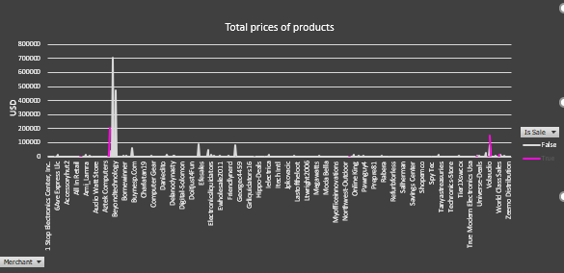
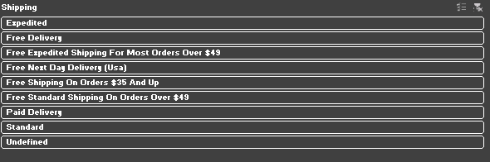
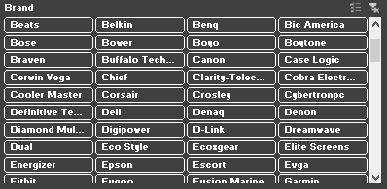

Upon entering the Excel file, five sheets are available: the original data sheet, the modified data sheet, "PivotTable" sheet, "BarChart" sheet and "Dashboard" sheet. In the "PivotTable" sheet the "Is Sale" column serves as the column field, the "Merchant" column as the row field and the "Sum of Price" as the values of the Pivot Table. This configuration allows for a structured and insightful analysis of sales data based on merchants and sale status. In the Pivot Table, three slicers have been implemented to facilitate dynamic filtering: "Shipping", "Product Condition" and "Brand" columns. These slicers empower users to interactively explore and analyze the dataset, providing a user-friendly and customizable experience for refining the displayed information based on specific criteria. This graphical representation offers a concise and insightful overview of the data, allowing for easy interpretation of trends and patterns derived from the Pivot Table analysis.

Slide 17
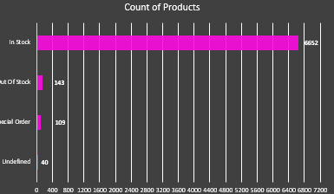
On the "BarChart" sheet, a second Pivot Table has been constructed, utilizing the "Product Availability" column as the row field and the "Count of Product ID" as the values of the PivotTable. Subsequently, a Bar chart has been inserted to visually represent this analysis, offering an effective way to convey the distribution and count of product availability categories. The culmination of the project is encapsulated in the "Dashboard" sheet. Here, an interactive analysis awaits, enabled by various slicers that dynamically modify graphics based on user selections. A distinct feature includes the ability to focus on a specific merchant's analysis by clicking the "Merchant" button on the line chart and making selections. This comprehensive dashboard offers a user-centric and customizable approach to exploring and interpreting the dataset's insights. You can see my final dashboard on next page

Slide 18
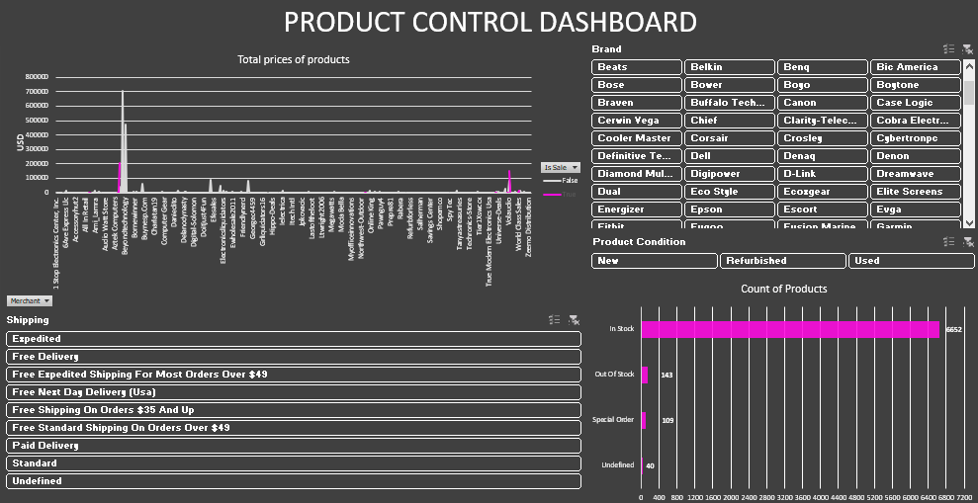

Slide 19
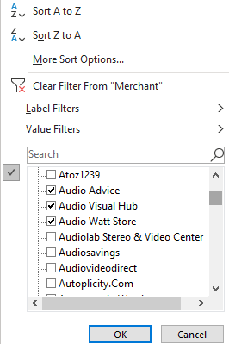

By filtering the Merchant column and selecting specific criteria, such as "Paid Delivery" and "Standard" in the Shipping slicer, "Kenwood", "Lenova", "Lowepro" and "Kensington" in the Brand slicer and "Used" in the Product Condition slicer, the associated charts dynamically reflect the corresponding changes. This granular exploration allows for a detailed review of the dataset, observing how the numbers and trends alter based on the defined parameters. Let’s check my dashboard in this situation ->

Slide 20
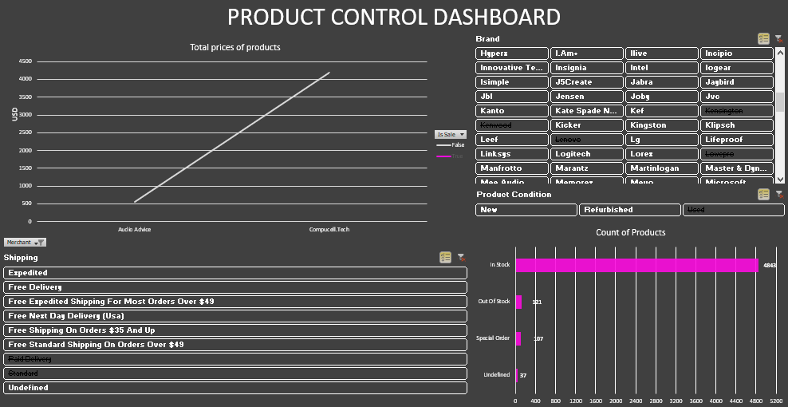

Slide 21

Thank You
Any question?
sevdaheyder1234@gmail.com

